Slide 1

University Institute of Liberal Arts and Humanities
Course Name: Communication Skills
Course Code: 23PCH-105
Listening and speaking skills
DISCOVER . LEARN . EMPOWER

Slide 2
COURSE OBJECTIVES
The Course aims to:
1 | Augment students overall communication and interpersonal skills by making them realize the importance of good oral and written English Language in professional life.
2 | Enrich their reading capability with special emphasis on expanding vocabulary and grammatical formations.
3 | Build exceptional speaking, reading and writing skills by correcting grammatical errors and pronunciation through practice.
4 | Enhances soft skills by fostering self awareness, confidence and a positive attitude in students’ ability to communicate effectively in English.

Slide 3
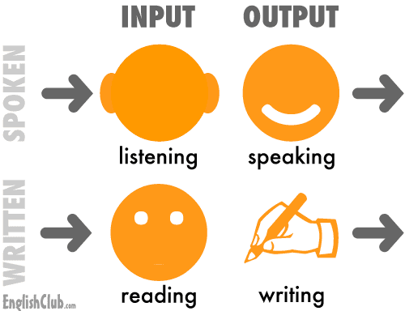
Course Outcomes
On completion, the students are expected to:
CO Number | Title | Level
CO1 | Apply appropriate Listening, Speaking, Reading and Writing Skills (LSRW Skills) with correct non-verbal cues to attain expertise in soft skills. | Apply
CO2 | Apply correct contextual and comprehensible written text in the form of paragraph writing, short compositions business correspondence, using logical support and argument in a wide range of communication situations. | Apply
CO3 | Demonstrate linguistic competence while speaking and during presentations through accuracy in grammatical usage, vocabulary, pronunciation and intonation. | Apply
CO4 | Evaluate information as critical readers, speakers and writers applying ethics in communication and being sensitive in cross cultural communication. | Evaluate
CO5 | Create original, digital content for websites, blogs, vlogs and personal social media profiles etc. | Create

Slide 4


Techniques for building LS Skills
The most important thing in communication is hearing what isn't being said. The art of reading between the lines is a lifelong quest of the wise.
-Shannon L. Alder
www. blog.thewellnessuniverse.com

Slide 5
Listening Skills
Listening is not just about being quiet while someone else is speaking. • Listening is with the Mind. • Hearing with the senses. • Listening is conscious. • To improve our interpersonal & oral exchange.
Just Listening to words is not enough; a good Listener has to pay attention to the non-verbal communication of the speaker.

Slide 6
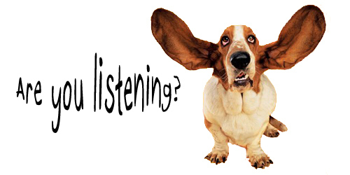
Effective Listening
Effective Listening is the process of analyzing sounds, organizing them into recognizable patterns, interpreting the patterns and understanding the message by inferring the meaning.
www.wordpress.com

Slide 7
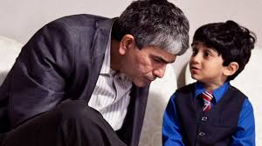
Listening V/S Hearing
Hearing - physical process; natural; passive
Listening - physical & mental process; active; learning process; a skill to develop.
Becoming an Active Listener:
Pay Attention
Show That You're Listening
Provide Feedback
Defer Judgment
Respond Appropriately
www. Gettingsmart.com

Slide 8
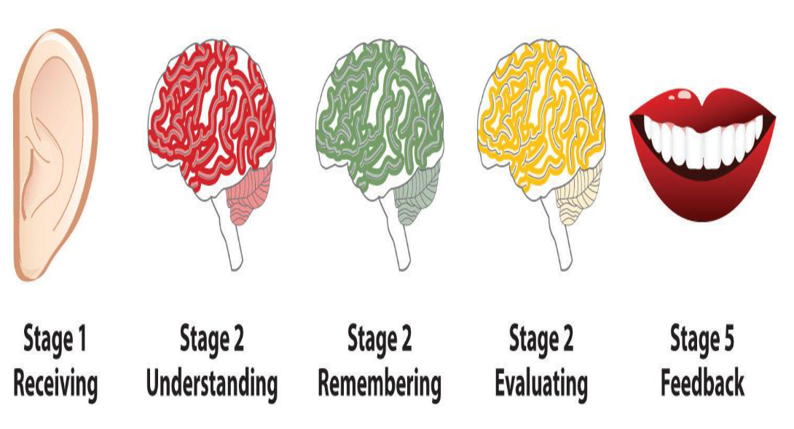
The Process of Listening:

Slide 9
Types of listening
DISCRIMINATIVE LISTENING – It involves identifying the difference between various sounds.
COMPREHENSION LISTENING – It involves attaching meaning to what is being listened to.
EVALUATIVE LISTENING – It involves evaluating and analyzing the message being received.
SELECTIVE LISTENING – It involves selecting the desired part of the message and ignoring the undesired part of the message.

Slide 10
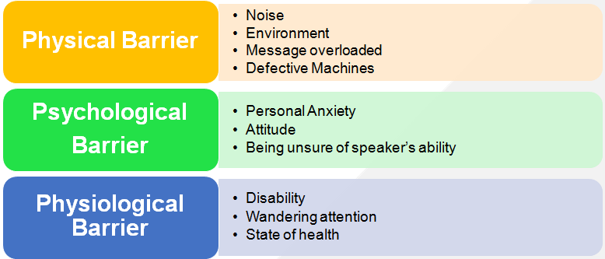
Barriers to Effective Listening

Slide 11
References
https://www.fastcompany.com/3036026/5-ways-to-improve-your-listening-skills
https://www.stevenaitchison.co.uk/5-ways-improve-listening-skills/
https://www.mindtools.com › Communication Skills › Communicating in Person
https://www.mindtools.com/CommSkll/ActiveListening.htm

Slide 12
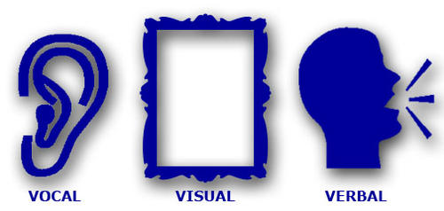
Speaking Skills
Speaking skills are the skills that give us the ability to communicate effectively.
These skills allow the speaker, to convey his message in a passionate, thoughtful, and convincing manner.
Speaking skills also help to assure that one won’t be misunderstood by those who are listening.
7% VERBAL- words spoken
38% VOCAL- tone, range, appeal, credibility of voice
55% VISUAL- physical appearance, gestures, eye contact

Slide 13
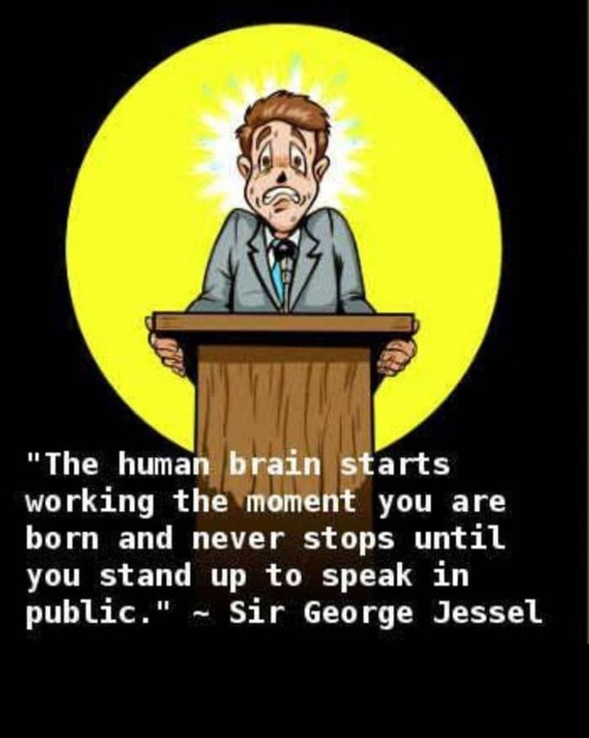
Articulation
It involves the use of the organs of speech to produce sounds.
Sounds are produced in a continuous stream, some sounds merge with others. E.g.. Handbag, baked beans
Continual changes in loudness, pitch direction and pausing serve to organize the sounds into meaningful words and sentences.

Slide 14
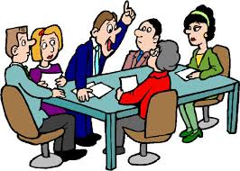
Kinds of Speaking Situations
Interactive speaking situations include face-to-face conversations or telephone calls, in which we are alternately listening and speaking, and in which we have a chance to ask for clarification, repetition, or slower speech from our conversation partner.

Slide 15
Kinds of Speaking Situations
Partially interactive as when giving a speech to a live audience, where the audience does not interrupt the speech. The speaker nevertheless can see the audience and judge from the expressions on their faces and body language whether or not he or she is being understood.
Totally non-interactive as when recording a speech for a radio broadcast.

Slide 16
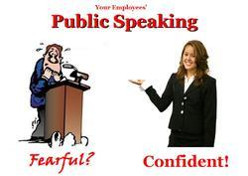
Tone
The tone is responsible for about 35-40 percent of the message we are sending. Tone involves the volume you use, the level and type of emotion that you communicate and the emphasis that you place on the words that you choose.
Personalitytutor.com

Slide 17
Rhythm
Rhythm is the pattern of the sounds you produce.
Stressing and de-stressing syllables and words gives us rhythm in English.
Rhythm is the music of English Language – the ups and downs and the linking of words, which together, change how we say sentences.

Slide 18
Pitch
Pitch is the highness or lowness of your voice, and it’s incredibly essential in language
We use pitch in order
to express our emotions and attitude through a change in our intonation, or the tone of our voice.
to express stress, or when we make certain syllables longer, louder, and higher in pitch.

Slide 19
Stress
Stressing means to emphasize a sound and make syllables and words: louder ,longer and higher in pitch
Every word in English has just one syllable with a primary stress or emphasis.
It is not only essential to stress certain syllables and words, but we must also de-stress other syllables and words.
Example: English –> [ING glish] (1st syllable is stressed; 2nd syllable is slightly de-stressed)

Slide 20
Stress in sentences
Think about stressed as well as unstressed Syllable while pronouncing a word/ sentence.
How about we go for a Coffee this afternoon.
Content words
Grammar
My Phone’s broken, so I am going to buy a new one.
Zaffar and other speakers addressed the August Gathering of participants.

Slide 21
Intonation
Intonation refers to the rise and fall in human voice.
Questions, for example, should end on a higher note.
Affirmative statements should end in a level or slightly lower pitch. The ending of statements on a high pitch can create doubt in your listeners.
The entire variation of pitch while speaking is called intonation.
Words that are stressed are key to understanding and using the correct intonation brings out the meaning.

Slide 22
Practice Exercise
A sentence can be spoken differently, depending on the speaker's intention.
Look at the following sentences. Speak them out loud and especially stress the word that is in bold writing.
I did not read anything about the disaster.
I did not read anything about the disaster.
I did not read anything about the disaster.
I did not read anything about the disaster.
I did not read anything about the disaster.
I did not read anything about the disaster.

Slide 23
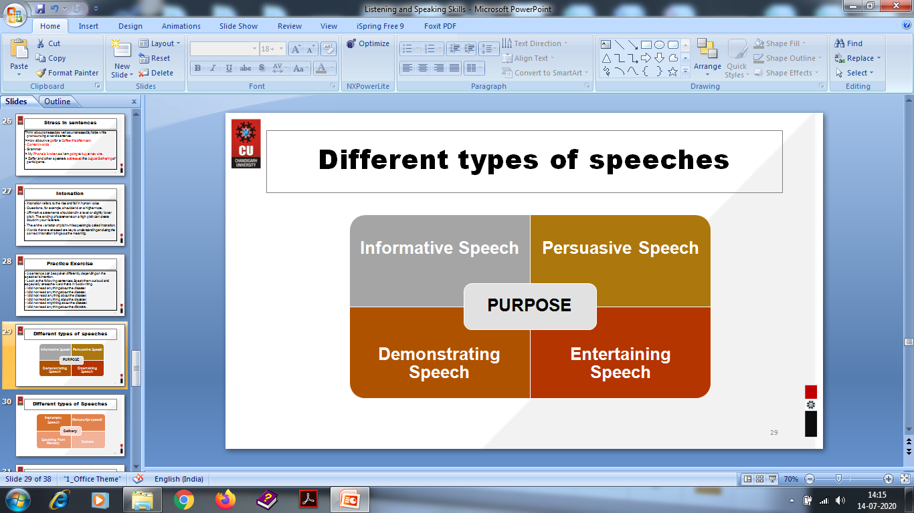
Different types of speeches

Slide 24
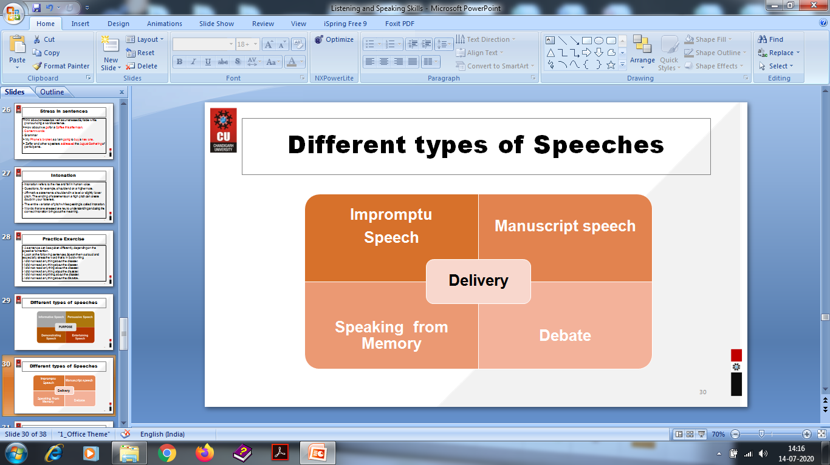
Different types of Speeches

Slide 25
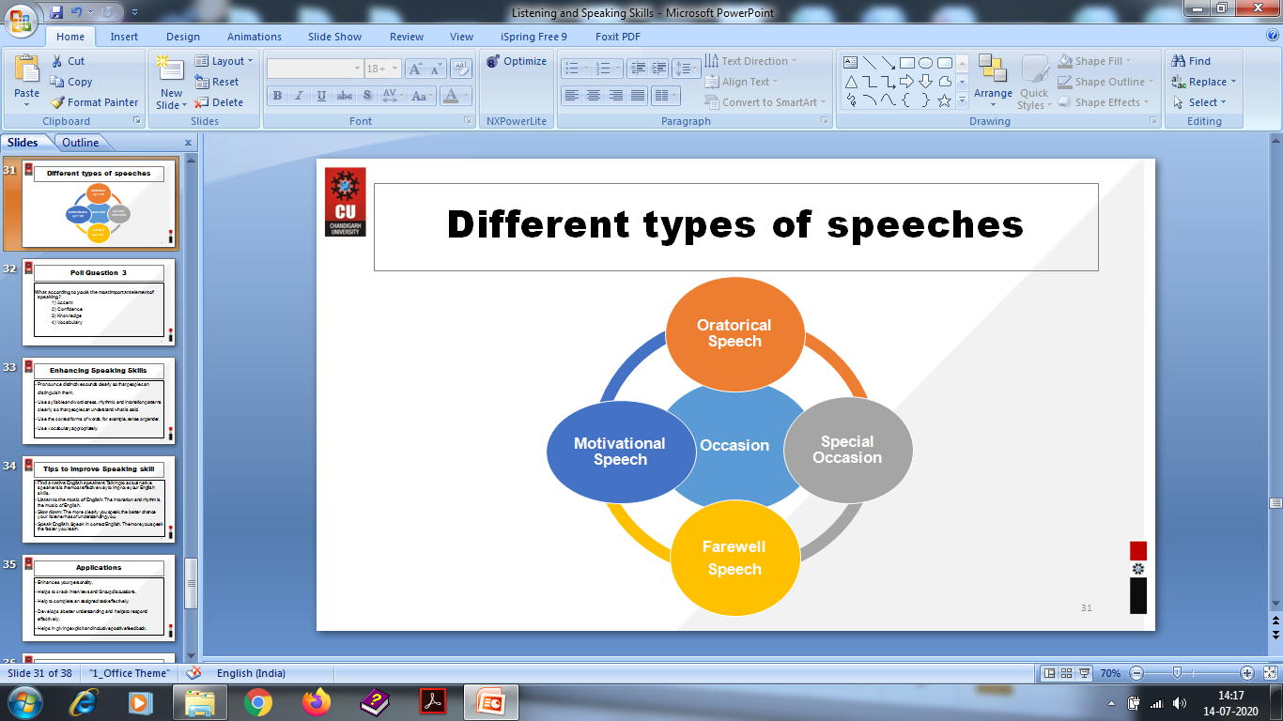
Different types of speeches

Slide 26
Enhancing Speaking Skills
Pronounce distinctive sounds clearly so that people can distinguish them.
Use syllable and word stress, rhythmic and intonation patterns clearly so that people can understand what is said.
Use the correct forms of words, for example, tense or gender.
Use vocabulary appropriately.

Slide 27
Tips to improve Speaking skill
Find a native English speakers: Talking to actual native speakers is the most effective way to improve your English skills.
Listen to the music of English: The intonation and rhythm is the music of English.
Slow down: The more clearly you speak, the better chance your listener has of understanding you.
Speak English: Speak in correct English. The more you speak the faster you learn.

Slide 28
Applications
Enhances your personality.
Helps to crack Interviews and Group discussions.
Help to complete an assigned task effectively.
Develops a better understanding and helps to respond effectively.
Helps in giving explicit and inclusive positive feedback.

Slide 29
Assessment Pattern
Students are assessed on the basis of the following parameters:
Hourly Tests - 2
Assignments
Surprise Test
Quiz
Student Engagement
End Semester Exam

Slide 30
References
https://www.fastcompany.com/3036026/5-ways-to-improve-your-listening-skills
https://www.stevenaitchison.co.uk/5-ways-improve-listening-skills/
https://www.mindtools.com › Communication Skills › Communicating in Person

Slide 31
THANK YOU
For queries
Email: communicationskills.uilah@gmail.com

